Slide 1
REGIONAL COMMUNICATION GUIDELINES FOR LATIN AMERICA & AFRICAN COUNTRIES
17th January 2022
Work package 5 (task 5.2)
Rita Costa Abecasis, Sabrina Gaber

Slide 2
Agenda
Presentation: 20 min.
Q&A and discussion: 10 min.
Questions
Discussion
How to ensure dissemination & application of the guidelines?
Sustainability beyond project end
Next steps?
Notes:
First I’ll quickly cover the overall goal of the guidelines – or what we set out to do; then I’ll talk about who was involved (besides myself) and the approach we took to developing the guidelines; and then, I’ll briefly present the survey, which was the “heart” of the guidelines, before going into more detail about the two guideline documents themselves, highlighting key takeways from both.

Slide 3
What we set out to achieve
Goal: provide a roadmap to facilitate communications, further enhance awareness of research infrastructures (RIs), and drive collaboration with stakeholders (eg scientists, research organisations) in 2 of the 3 ‘RI-VIS’ regions:
Latin America
Africa
Guidelines designed to help EU RI communications officers as well as RI managers & relevant staff to create their own communications strategies, taking into consideration factors that may help or hinder them in communicating effectively with different stakeholders
Not intended to be a directory or contact list
Notes:
It’s worth nothing that the original goal (pre-COVID) was to organise back-to-back events in an international conference on RIs. The written guidelines are the fruit of the project amendment

Slide 4
How we got started
Task leaders: Sabrina Gaber, Communications Officer, European Marine Biological Resource Centre – EMBRC; Rita Costa Abecasis, Communications Manager, EMBRC Portugal / Centre of Marine Sciences – CCMAR
Starting point: RI-VIS communications toolkit (learn more), three white papers, outputs of the Symposia (Latin America, Africa)
Approach: development of a survey to compile information from local stakeholders and individuals with in-depth knowledge of the regions (more to come!)
Creation of two Organising Committees (project stakeholder recommendation) to oversee survey development, dissemination, & analysis and guideline validation

Slide 5
Organising Committees
2 Organising Committees, including task leaders, a senior RI representative, and a local representative:
Latin America:
Adelino V. M. Canário, Director, CCMAR; Andrés López Lara, Head of the Equipment and Infrastructure Department, National Contact Point – Research Infrastructures; National Research and Development Agency, ANID; Ministry of Science, Technology, Innovation and Knowledge Chilean Government
Africa:
Bahne Stechmann, Head of Operations & Scientific Strategy, EU-OPENSCREEN; Daniel Adams, Chief Director: Basic Sciences and Infrastructure, Department of Science and Innovation (Republic of South Africa)
Instrumental role in providing a local perspective, highlighting any issues with survey, getting respondents to fill out the survey
Notes:
Idea for the Organising Committees came from senior RI-VIS project stakeholders. In terms of composition, we had a senior RI stakeholder, and a senior regional stakeholder (in addition to Rita/Sabrina)

Slide 6
Survey
The survey aimed to assess existing awareness and understanding of European RIs and identify the main interests and goals, as well as the main constraints in terms of engaging with European RIs for 4 pre-identified groups:
Individual scientists
Research organisations / institutions
Research networks / associations
Government entities
Goal: approx. 20 respondents per region
Both open-ended questions and tick-box or drop-down options
1 survey (English), adapted to each region; slight changes made prior to dissemination to African stakeholders
https://www.ccmar.ualg.pt/en/webform/improving-communication-eu-research-infrastructures-latin-america-stakeholders
https://www.ccmar.ualg.pt/webform/improving-communication-eu-ri-africa
Notes:
From survey:
EU research infrastructures are organisations that enable the research community to use specific facilities, resources and services in order to accelerate scientific achievements and promote sustainable research. The opportunities and benefits that EU research infrastructures (RIs) provide are not limited to the European region – in fact, there is growing interest to cooperate with other regions of the world, including Latin America. Yet, communicating what these RIs are, how they work and the opportunities they provide has proved to be a challenge.
This survey aims to provide information to European research infrastructures on how to better engage with researchers in Latin America, and increase their visibility among potential users.
The survey is part of a study that will deliver region-specific communication guidelines that European research infrastructures may implement in order to reach out to Latin American stakeholders, on the one hand, and to increase their visibility so that Latin American stakeholders may contact them, on the other hand. This study is part of the RI-VIS project, which aims to increase the visibility of European research infrastructures.
Timing: Latin America survey sent early August, reminders sent early September; survey closed September 17th – there was consensus that we did not have a representative country sample. Perhaps this is a lesson learned to keep in mind for future potential surveys/projects; to have pre-existing goals in terms of country representation, and a plan for how to achieve that. Here we relied heavily on Andres’s contacts; we’re not quite sure how we got from Chile to Nicaragua (!)
Africa survey, sent mid October, we gave them approximately two weeks. Timing was tighter for this second guideline document.

Slide 7
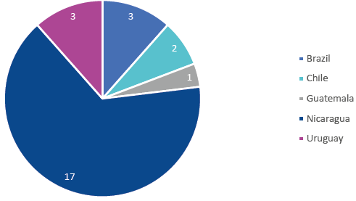
Survey results: Latin America
Targets:
Contributors to RI-VIS white paper: ‘Recommendations towards cooperation between Latin American and European research infrastructures’
Individuals recommended by the Organising Committee, particularly Andrés López Lara
Country distribution: Brazil, Chile, Guatemala, Nicaragua, Uruguay
Result: 26 responses (in either English or Spanish)
Majority researchers (11) &/or academics (14)*, policymakers/decision-makers (6), RI managers (6), industry (2), other (2)
Notes:
Indeed, we had a disproportionate number of respondents from Nicaragua.
Requests sent mainly by Andrés; support from Claudia Alén Amaro and Natalie Haley
The goal, however, was not to provide a country-by-country analysis of stakeholder perceptions of RI’s, but rather, to capture local perceptions regarding RIs to inform context-appropriate communications strategies/techniques. As such, the Organising Committee felt as if it could extrapolate the results and make them applicable in general.

Slide 8
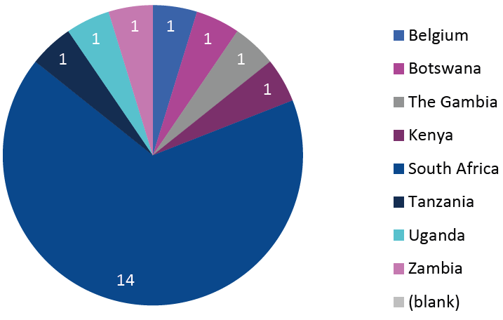
Survey results: African countries
Targets:
Same approach as for Latin America
Country distribution: Belgium, Botswana, Kenya, South Africa, Tanzania, The Gambia, Uganda, Zambia (1 not indicated)
Result: 22 responses
High-level scientists and directors (eg unit director, chief director, head of department, professor, researcher) working in research centres, universities, or similar academic institutions
One particularity of this group: some European respondents (with in-depth knowledge of the region)
Notes:
As stated in the Introduction, in all, 22 individuals responded to the survey, all of whom provided their consent to be authors of these guidelines and to share their findings. The country split for the 22 respondents is as follows: Belgium (1), Botswana (1), Kenya (1), South Africa (14), Tanzania (1), The Gambia (1), Uganda (1), Zambia (1), not indicated (1) (see Figure below).
Indeed, we had a disproportionate number of respondents from South Africa (63.6%) (and from southern, English-speaking African countries in general).

Slide 9
Main takeaways: main interests, goals
Strong desire for collaborative approaches, involving local stakeholders in project design/leadership (beware of top-down approaches!)
Knowledge-sharing and capacity-building opportunities to meet local needs: staff exchanges and training
Science diplomacy (particularly for African countries)
Internationalisation of research and publication opportunities
Interest in gaining access to state-of-the-art equipment and services in Europe but not necessarily using EU RI services at full-market cost (see constraints)
Notes:
Some of the findings are applicable to other regions: the need for cultural sensitivity, awareness of the local socio-economic/political context, attention to language (and the nuances certain terms may carry), the need for clear captivating messages, the importance of collaborative approaches (involving the non-EU participants as leaders in project design), etc. Ultimately, communication serves to support organisational objectives; here we can see that communication can also inform RIs’ international outreach strategies, providing a new lens to see and engage with the world.
. This highlights the need for EU RIs to have appropriate outreach strategies in place, with pre-identified contact points and a process for responding to inquiries (in addition to seeking collaboration).

Slide 10
Main takeaways: constraints
Funding
Potential linguistic barriers (all regions)
Difficulty knowing how to reach out to EU RI stakeholders and ensure timely follow-up
This inspired our 2-pronged approach: an ‘active’ and ’passive’ strategy; a toolkit to actively reach out to international stakeholders, and tips on how to make your EU RI more findable, and understandable to international users looking for information online
Notes:
Regarding linguistic barriers, some of the Latin American respondents responded to the English survey in Spanish; this was not the case, for African country respondents, but this can also be explained by the fact that they came from English-speaking African countries. There could likely be linguistic barriers for French-speaking or non-English speaking African countries.

Slide 11
The guidelines: a quick overview
Step 1: Do your homework
Identify and read background materials, identify existing collaboration with other RI’s
Read literature to better understand the national/regional politics and see how your RI can add value by (co-)developing context-appropriate solutions to meet local needs
Step 2: Identity your communications goals
Align communications goals with business goals
Be clear in your expectations
Keep in mind your targets’ goals when developing your own, and adapt as needed

Slide 12
The guidelines: a quick overview
Step 3: Identify and get to know your target audiences
Coordinate with your RI peers to identify potentially interested parties or ‘target audiences’
Consider all target audiences (ie primary and secondary)
To engage with researchers, you may need to reach them via an alternative route (eg by contacting their university network)
Consider additional audiences which may be very important in disseminating information and/or enabling collaboration (funders, governments, etc.)
Consider in-person events such as community engagement workshops to better understand local needs and how your RI and local stakeholders could work together to address local needs

Slide 13
The guidelines: a quick overview
Step 4: Develop your key messages (1/2)
People have differing understandings of an RI, so start with a basic definition and highlight your RI’s specific areas of research
Develop messages to grab stakeholders’ attention using phrases like ‘funding or knowledge-sharing opportunity’, ‘collaboration’, ‘science diplomacy’, ‘capacity building’, ‘increased visibility’
Keep in mind that words/messages may have a different meaning for different groups and within groups
Be aware of your ‘cultural baggage’ and how your own socio-cultural experience/lens can affect your communications
Notes:
Note for point 1:
Note that respondents often felt they knew what RI meant, but then provided different local equivalents, so it’s safe to assume that there is a degree of divergence in understanding and local equivalents. However, this may not necessarily be an issue in South Africa, which has its own RI roadmap and is very familiar with the concept.
2nd point, consider if you even need to use the term! It might just lead to greater confusion initially. Ease your audience into the concept if it’s novel.

Slide 14
The guidelines: a quick overview
Step 4: Develop your key messages (1/2)
Be clear on the proposed business model (for EU/African collaboration) and participation requirements for collaboration (eg cost of being a member of a consortium); if there are flexible paying models, present these, focusing on mutual benefit and return on investment

Slide 15
The guidelines: a quick overview
Step 5: Identify relevant activities, tools, channels
Make it easy to find relevant information for international audiences on your website (eg visible tab/link)
Use websites/blogs targeting local stakeholders to disseminate information; identify local newsletters and those for relevant H2020/Horizon Europe projects
Use social media and tag local thought leaders/relevant accounts
Create a mailing list for regional stakeholders and/or disseminate information via existing lists (coordinating with eg university or ministry press office)
Work with local press/media; participate in local events/conferences
Step 6: Evaluation
Develop a roadmap to evaluate and fine tune your regional communications strategy
Notes:
Note on language: While it may be useful to translate content for certain international stakeholders, the survey results did not imply that English would be a problem in English-speaking African countries

Slide 16
Food for thought (conclusions)
Guidelines may be helpful for the development of RIs’ international strategies, highlighting the need for a more holistic approach, considering:
Short, medium, long-term goals for your RI and the local partner(s) and mutual benefit
How do these goals contribute to regional development and meeting local needs? How will regional collaboration serve to fulfil your RI’s mission?
Funding: some countries may have national/regional funding mechanisms, some may expect the RI to come with funding (in some cases, there may be international funding, eg Bill & Melinda Gates Foundation); this should be explored during strategy development
Notes:
Provided that EU RIs clearly define (& then communicate) their value proposition and potential return on investment, this may incite international partners to financially contribute to collaboration or other agreements, and fund services

Slide 17
Discussion and links
Discussion
How to ensure dissemination & application of the guidelines?
Sustainability beyond project end
Lessons learned and how to apply to future projects/collaboration?
Where to find the guidelines?
Latin America: https://zenodo.org/record/5793657
African countries: https://zenodo.org/record/5793442

