Slide 1
Future of international Research Infrastructure collaborations
Patricia Postigo McLaughlin
DG Research & Innovation
European Commission
Pierre Quertenmont
European Research Executive Agency - REA
#ResearchInfrastructures
#ResearchImpactEU
#EUResearchArea
#HorizonEU

Slide 2
The EU Research Infrastructure programme
Part of the EU Framework Programme for Research and Innovation:
Horizon 2020 (2014-2020)
Horizon Europe (2021-2027)
Supports RI communities in all fields
Funds:
RI design and preparation
Service provision (transnational/virtual access)
International by nature

Slide 3
What do we support?

Slide 4
International: RI design and preparation
Within the pan-European RI landscape established by ESFRI: grants for preparatory work of new RIs or upgrade of existing RIs.
Usually based in Europe, but sometimes the facilities are not located on the EU territory (ex.: Astronomy).
EU programme support is provided through the participation of EU entities in the international venture (as lead or as contributor).
© SKAO

Slide 5
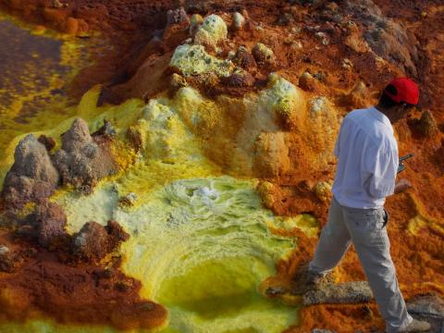
International: service provision
The EU RI programme funds transnational access (TA) and virtual access (VA) to research infrastructure services.
Funds are granted to RI consortia, which run their own call for proposals.
Access is also open to international users (up to 20%, or more if duly justified), depending on the field and on the call.
Non-EU RIs can also participate in consortia and grant access to their facilities (on EU or own funds, depending on country and EU call).
Examples:
Europlanet2024 (planetary analogues
in Botswana and Ethiopia)
INTERACT

Slide 6
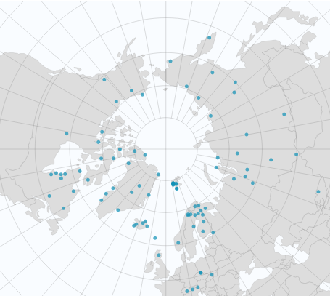
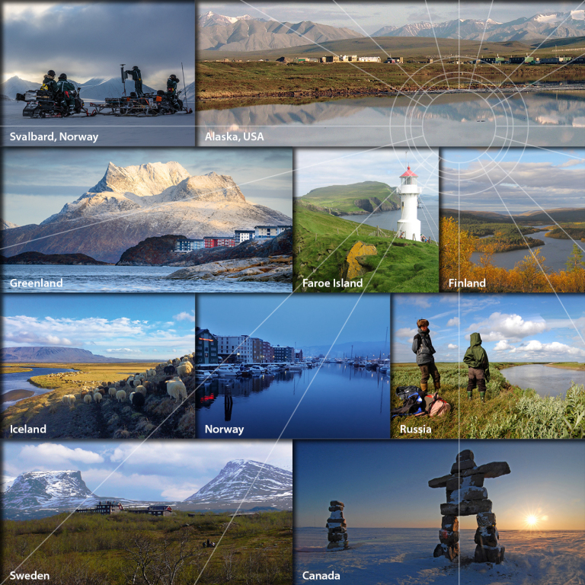
© INTERACT
© INTERACT

Slide 7
RI programme is international by nature
RIs are international communities, extending beyond the borders of the EU:
Science cases are complex and require international collaboration
Fields are of a global nature (ex: climate and environmental monitoring, global health…)
Big RIs are costly, require funding at international scale
Expertise is scarce and must be shared
RI people are international professionals

Slide 8
International: support to policy
Grants supporting international cooperation policy:
Projects supporting international landscaping, visibility of RIs, international RI cooperation: RISCAPE, RI-VIS, support to ICRI…
Projects with a geographical scope:
EU-Russia: CREMLINplus (cooperation between major RIs, access to Russian RIs, science diplomacy)
EU-Africa: B3-Africa (biobanking), SEACRIFOG (Food Security and Greenhouse Gas Observations), JUMPING-JIVE (capacity building in radio-astronomy)…
EU-Latin America and Caribbean: EU-LAC ResInfra (new bi-regional partnership on RIs)
EU-Middle East: BEATS (SESAME synchrotron in Jordan)

Slide 9
International in Horizon Europe
Continuation of the support to international cooperation
Example: the first INFRA call included a specific topic: “Strengthen the bilateral cooperation on research infrastructures with Africa: improving the knowledge base on climate change in Africa” (results will be published shortly!)
Other INCO topics in the following calls.

Slide 10
Future INFRA international activities
On 18 May 2021 the European Commission adopted a Communication outlining a global approach to research and innovation.
Alignment on: academic freedom; research ethics and integrity; gender equality, diversity and inclusiveness; open data and open science; setting global standards; and evidence-based policy making.
Focus on the policy priorities: the green deal and digitalisation.
Africa partnership (Communication March 2020, summit next month)
Maintain our collaboration with CELAC.

Slide 11
Future INFRA international activities
G7 working group on Research Infrastructures; foster international dialogue on RI collaboration – both in terms of international consortia around RI projects, such as SKA, or what could be defined as RI clustering (pooling existing national efforts, coordinating databases or service pipelines).
ICRI conference, 19-21 October in Brno, Czech Republic.

Slide 12
Thank you!
For more info:
Commission’s website on Research Infrastructures: https://ec.europa.eu/info/research-and-innovation/strategy/strategy-2020-2024/our-digital-future/european-research-infrastructures_en
Horizon Europe:
https://ec.europa.eu/info/research-and-innovation/funding/funding-opportunities/funding-programmes-and-open-calls/horizon-europe_en
European Strategy Forum on Research Infrastructures:
www.esfri.eu
Participant Portal (upcoming calls for proposals):
https://ec.europa.eu/info/funding-tenders/opportunities/portal/screen/home
Follow us:
Commissioner Mariya Gabriel: @GabrielMariya
Director-General Jean-Eric Paquet: @JEPaquetEU
Director of REA Marc Tachelet: @tachelet
DG Research and Innovation: @EUScienceInnov
REA: @REA_research

