Slide 1
RI Communication Toolkit
WP5 - Task 5.1
17 February 2022
Rita Abecasis (CCMAR/EMBRC)
Sabrina Gaber (EMBRC)
Natalie Haley (Instruct-ERIC)

Slide 2
RI Communication Toolkit
RI-VIS will increase the visibility of European RIs to broader scientific communities, industry and strategic partners in third countries.
Task 5.1. main goal: To deliver a common communication framework for RIs:
Specific stakeholder-group communication guidelines
Manual of best practice and materials with a common language and standards

Slide 3
RI Communication Toolkit
Deliverable:
Communication Toolkit
24 pages PDF document
Date - February 2020
Actions:
3 workshops targeting RI comms officers
Faro - Jun 2019 | Paris - Oct 2019 | Munich - Feb 2020
31 communication experts | 17 European RIs
Additional outcome:
Establishment of a “community of practice” composed of European RI Comms officers

Slide 4
RI Communication Toolkit
Harmonizing how we communicate RIs
optimizing RI websites
reaching out!
improving RI communication materials and activities

Slide 5
RI Communication Toolkit
Task 5.1 extended
New objectives:
To promote the use of the Communication Toolkit
To contribute to the implementation of a common communication framework for RIs
To encourage the development of a community of European RI Comms officers

Slide 6
RI Communication Toolkit
Task 5.1 - New milestone
New Skills for Communication Officers (MS9)
Rationale: a need for such training became apparent during the construction of the communication toolkit
Lead: EMBRC and CCMAR
Funding: budget remaining for the task 5.1 toolkit workshops
Format: online training activities

Slide 7
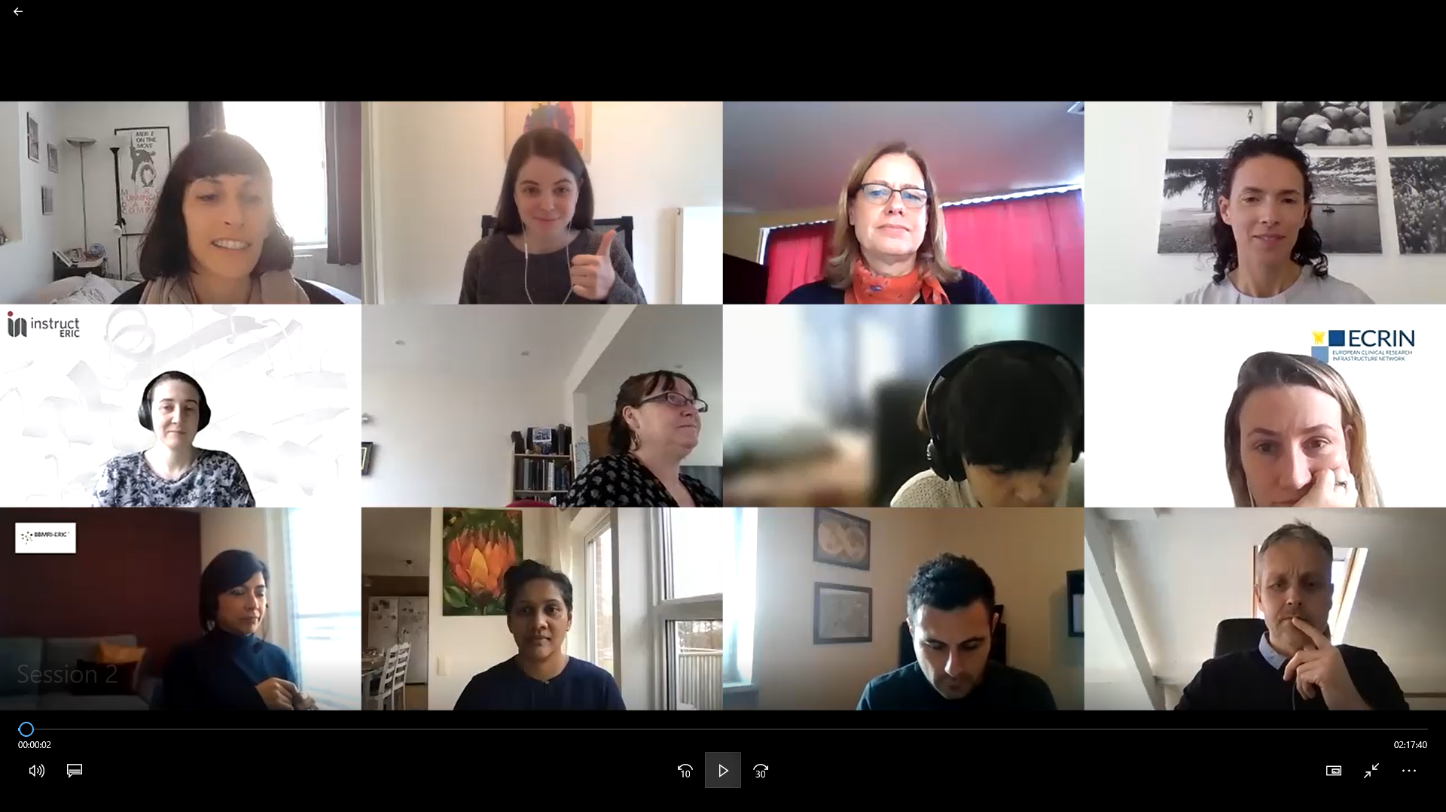
RI Communication Toolkit
New Skills for Communication Officers (MS9)
Dates: March – June 2021
Target: communication staff
42 Participants
19 RIs

Slide 8
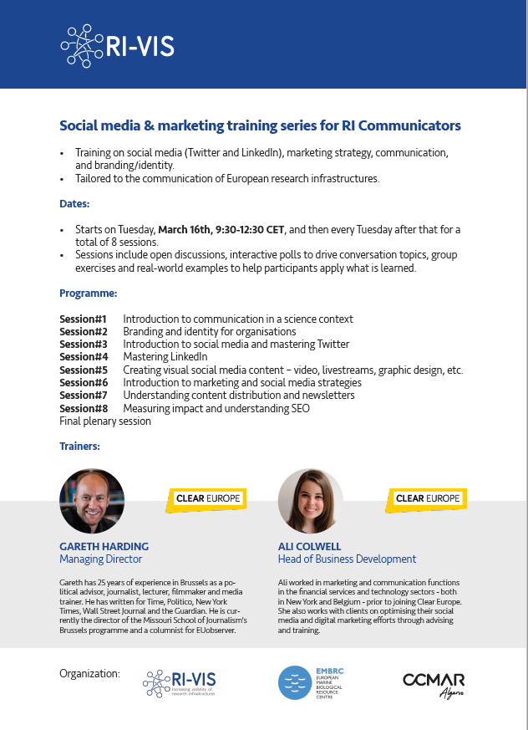
RI Communication Toolkit
New Skills for Communication Officers (MS9)
Contents: social media & marketing for research infrastructures
Program:
#1 - Introduction to communication in a science context (also open to RI Managers)
#2 - Branding and identity for organisations
#3 - Introduction to social media and mastering Twitter
#4 - Mastering LinkedIn
#5 - Creating visual social media content – video, livestreams, graphic design, etc.
#6 - Introduction to marketing and social media strategies
#7 - Understanding content distribution and newsletters
#8 - Measuring impact and understanding SEO
Final plenary session

Slide 9
RI Communication Toolkit
Task 5.1 - New deliverable
Online Communication Platform and Toolkit (D5.2)
Rationale: digital and user-friendly access will ensure a wider use of the communication toolkit
Lead: Instruct-ERIC and CCMAR
Funding: budget from task 5.1 and WP4
Target: communication staff

Slide 10
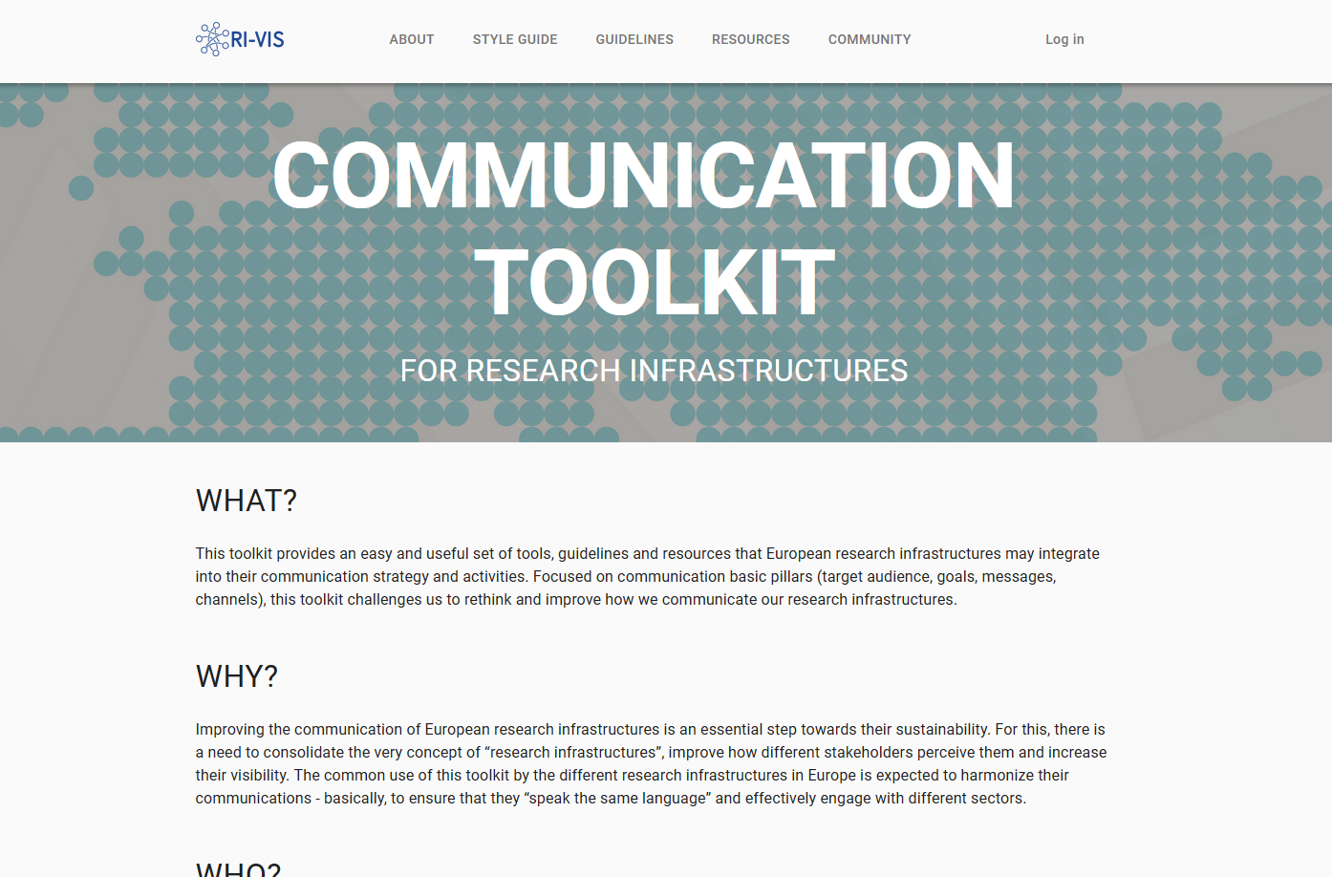
RI Communication Toolkit
Online Communication Platform and Toolkit (D5.2)
https://toolkit.ri-vis.eu/home
Format: online platform (ARIA), with custom features developed by Instruct
Contents: The RI Communication Toolkit contents were adapted for web use
Style guide
Guidelines

Slide 11
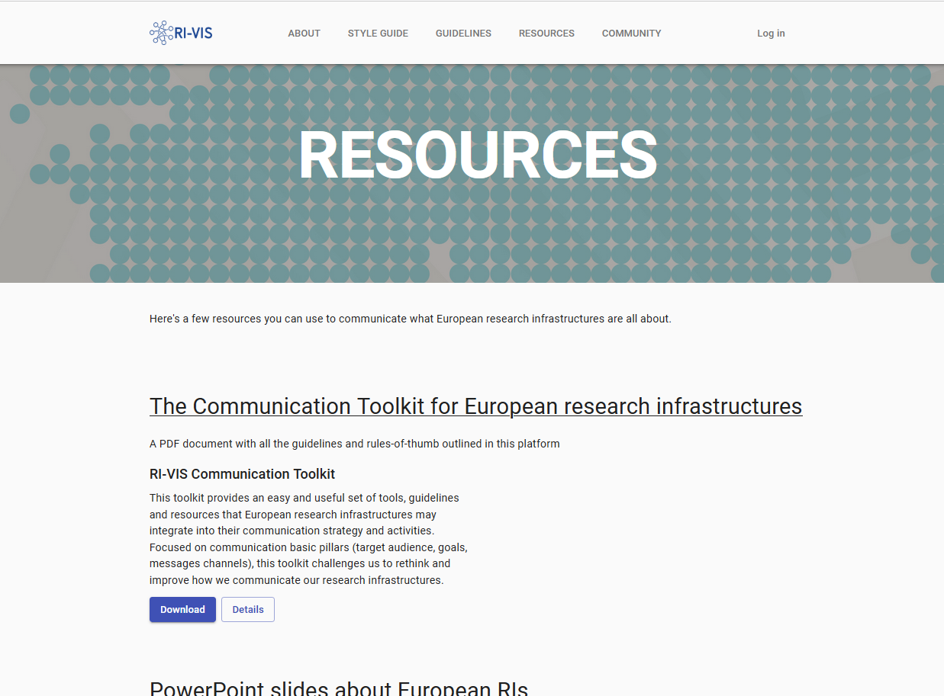
RI Communication Toolkit
Online Communication Platform and Toolkit (D5.2)
Contents: ‘Resources’ enables the online sharing of useful tools for the RI communication officers community
Docs (PDFs)
Videos & images
PPT slides
Etc.

Slide 12
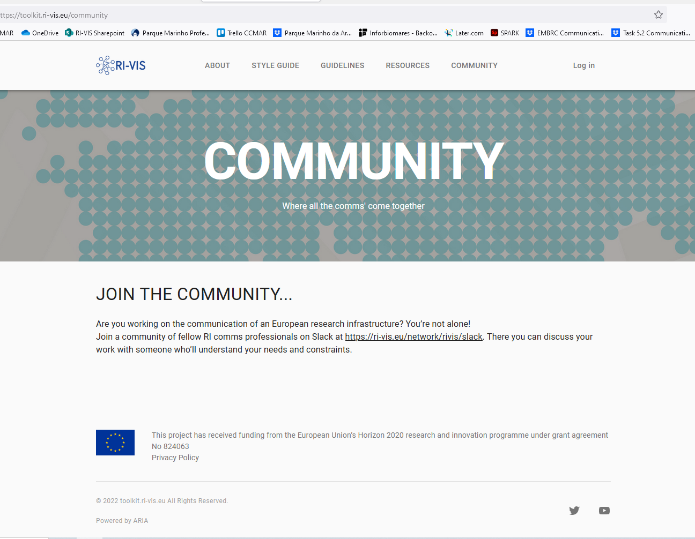
RI Communication Toolkit
Online Communication Platform and Toolkit (D5.2)
Community: link to Slack channel for RI Comms Professionals
https://ri-vis.eu/network/rivis/slack

Slide 13
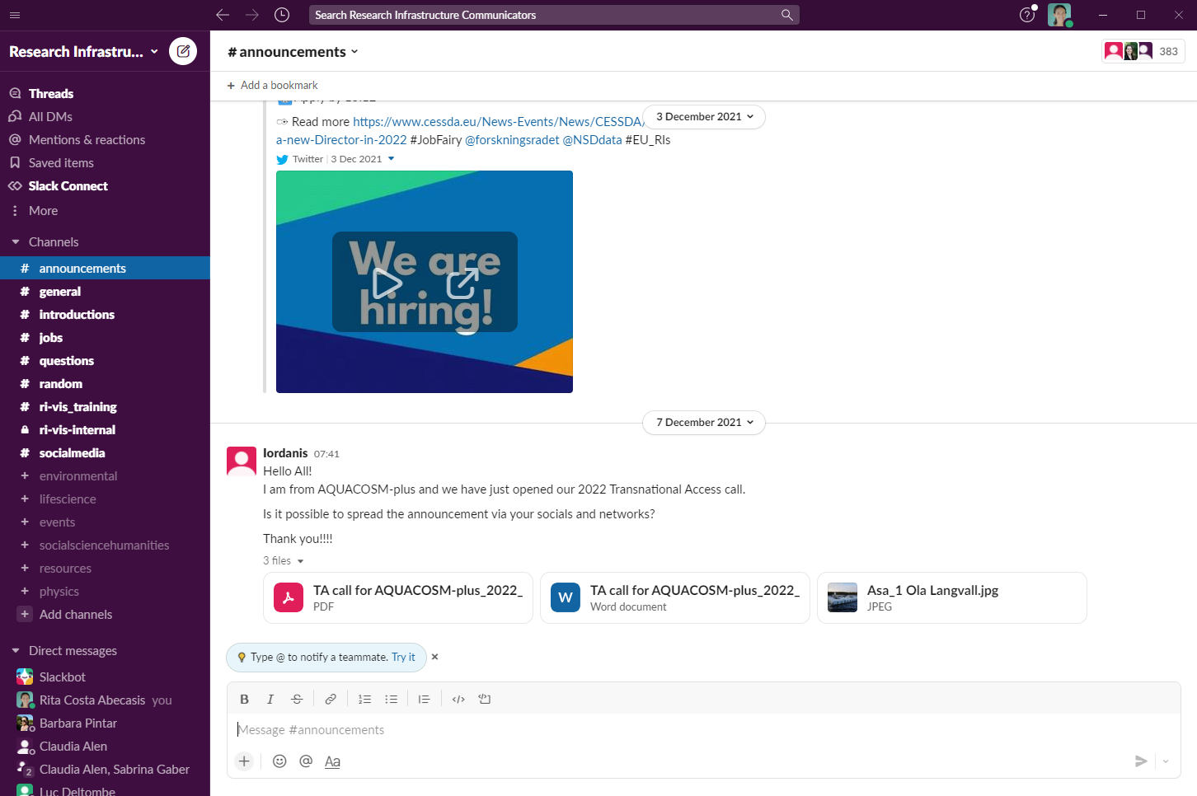
RI Communication Toolkit
Online Communication Platform and Toolkit (D5.2)
Community > Slack channel
Channel created and managed by Natalie Haley (Instruct-ERIC)
Currently 383 members
A user-friendly way to make announcements, share resources, ask questions and help each other out…
Building community!

Slide 14
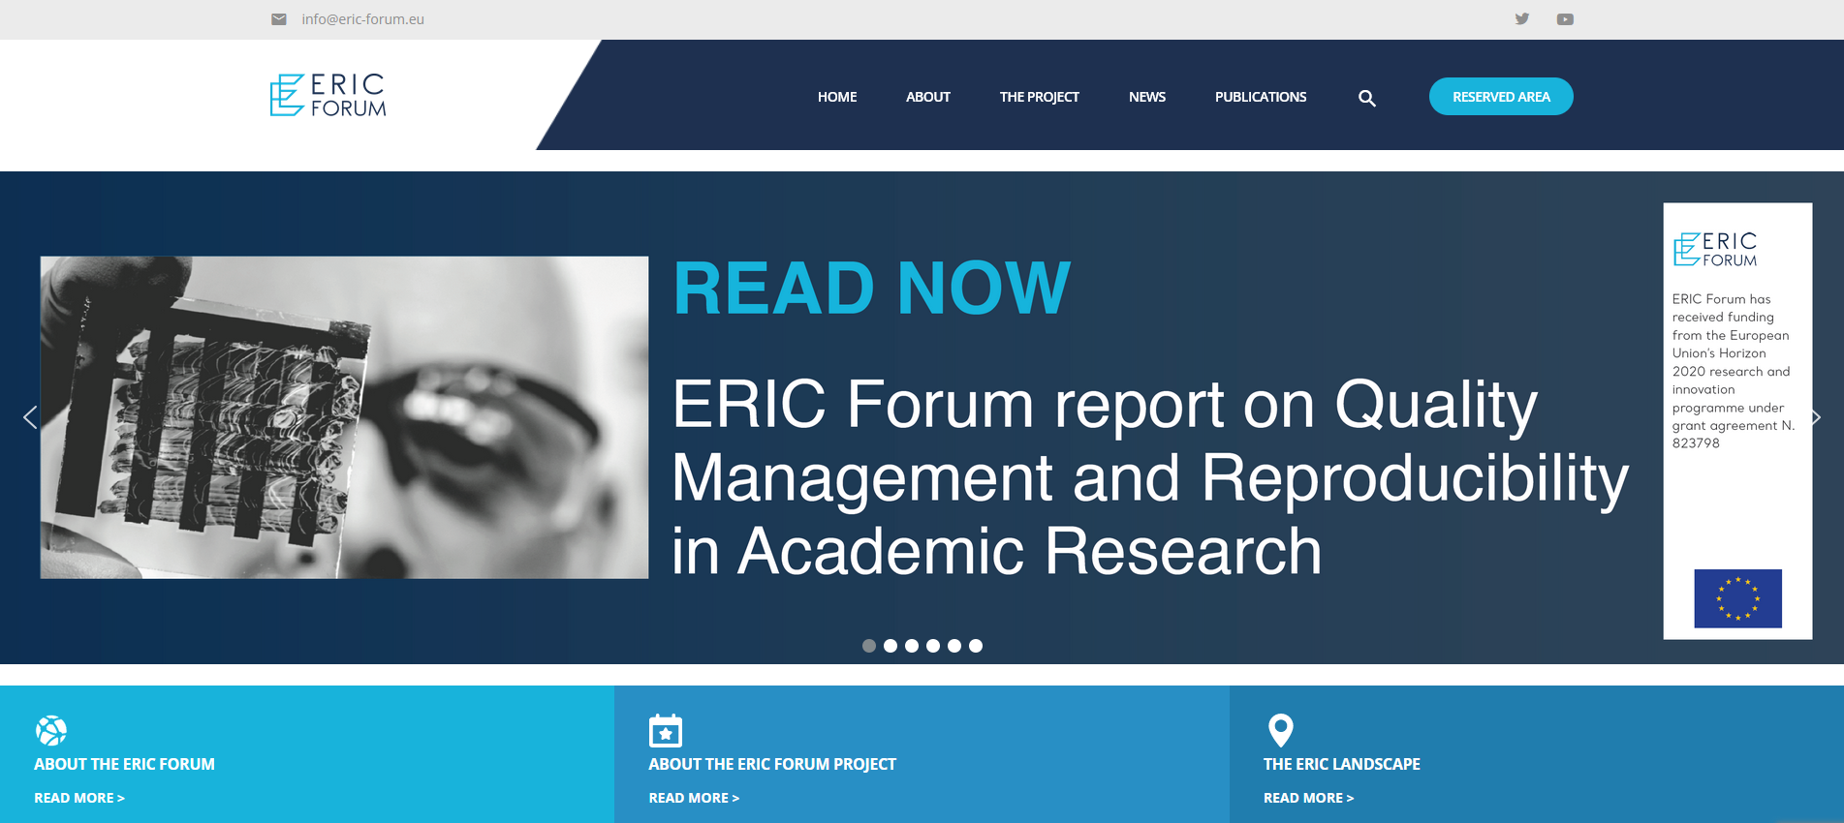
RI Communication Toolkit
SUSTAINABILITY
Articulation with ERIC-Forum
“RI Communication Toolkit” online platform to be hosted @ ERIC FORUM

Slide 15
RI Communication Toolkit
SUSTAINABILITY
Building a community of practice – up to the RI Comms Professionals!!
You can keep up the momentum by:
Using the slack channel to engage with other RI Comms Professionals
Sharing best practices and resources in the online platform (contact Instruct-ERIC)

Slide 16
RI Communication Toolkit
SUSTAINABILITY
Building a community of practice – up to the RI Comms Professionals!!
You can keep up the momentum by:
Using the slack channel to engage with other RI Comms Professionals
Sharing best practices and resources in the online platform (contact Instruct-ERIC)
Thank you!

