Slide 1
ARIA SiteBuilder
Natalie Haley (Instruct-ERIC)

Slide 2
What is ARIA?
ARIA is a cloud platform provided by Instruct
It offers a range of different RI services for different users
Microsoft Office 365 for Research Infrastructures
The most state of the art tool for managing research infrastructures
Used by 5 RIs
Used in 14 European Commission funded projects
Notes:
ARIA Is a cloud platform, providing a range of services for RIs to offer their users. A one-stop shop for users to carry out and manage access proposals, websites, facilities and so on

Slide 3
What is ARIA?
Notes:
Pillars, cores, tenets. NOT services

Slide 4
What is ARIA?
Notes:
Services

Slide 5
ARIA Users
More than 13,000 total ARIA users
Notes:
Important slide. Demonstrates both how ARIA is an interlinking network for multiple users, but also how it segregates areas for better security and usability. Lines indicate interaction between users, rather than communication (although also comm). One user can fulfil multiple roles here.

Slide 6
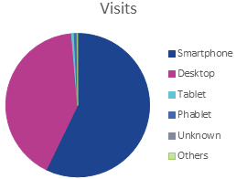
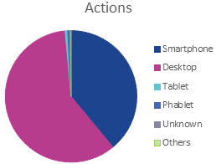
Why Sitebuilder?
RI-VIS performed a review of ARIA functionality: Identify areas to exploit for community information exchange
Content Management System identified as key
Sitebuilder
Improvements to usability and shareability
Tight integration with ARIA data sources
Mobile-friendly design
Conform to global theme
Haley, N., Nemytov, D., Povey, M., & Smith, C. (2020). “RI-VIS D4.1 Revision of ARIA for RI-VIS”. Zenodo. https://doi.org/10.5281/zenodo.3701205

Slide 7
ARIA Sitebuilder Product Tour

Slide 8
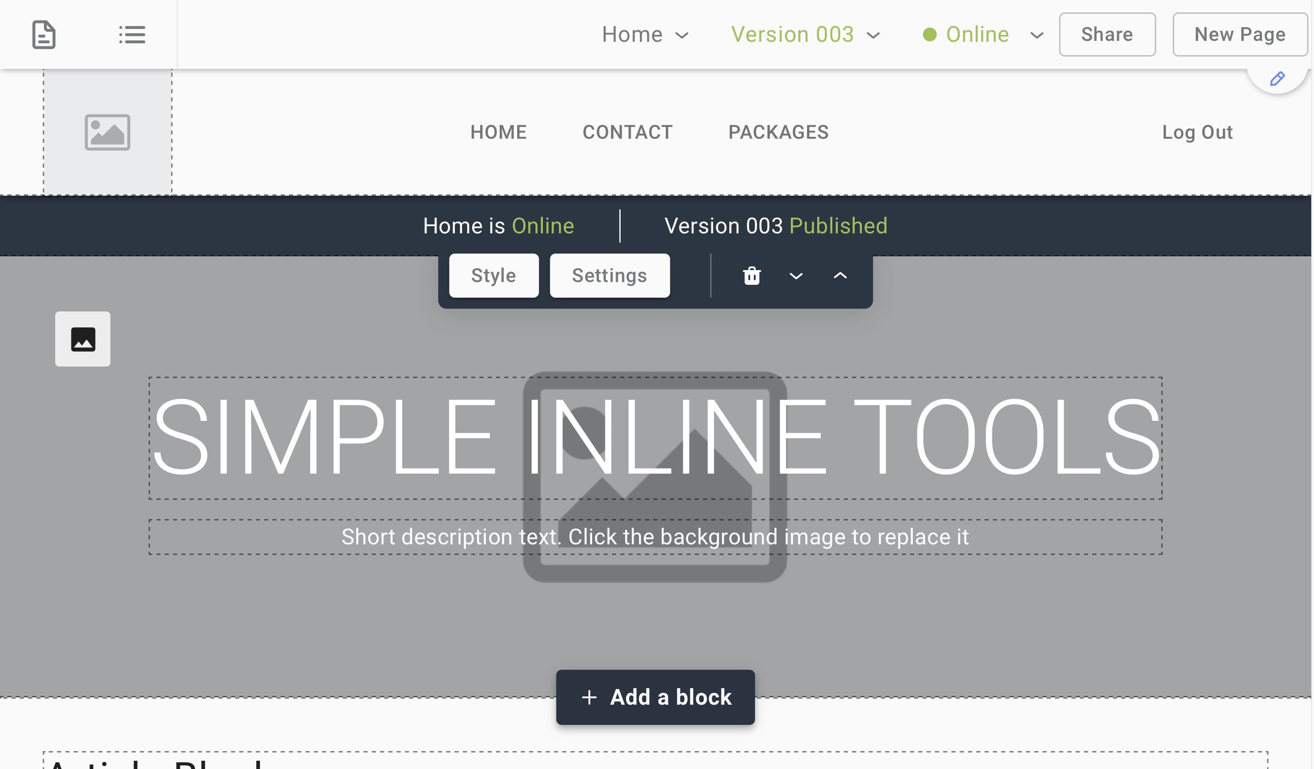
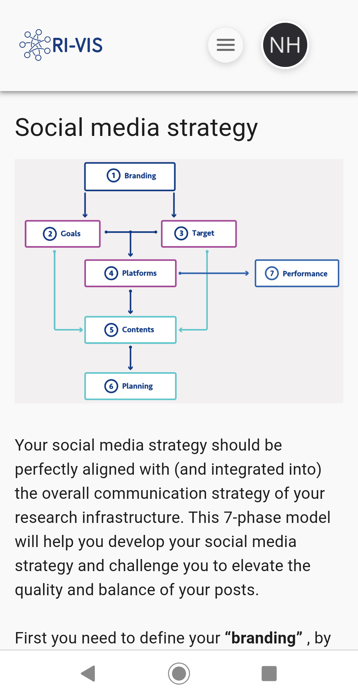
ARIA SiteBuilder: Features

Slide 9
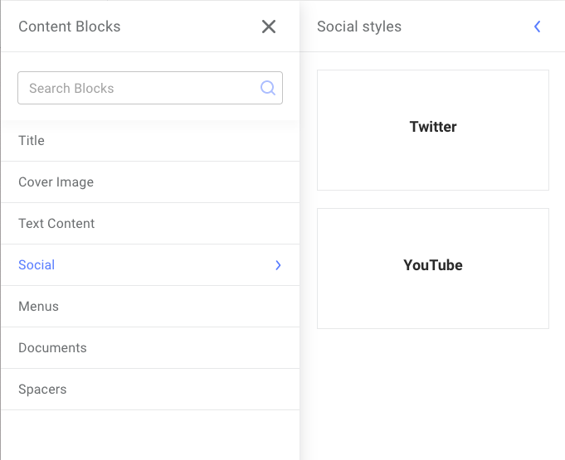
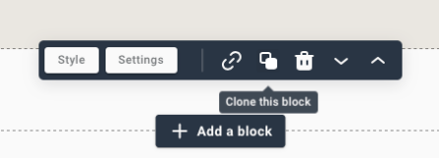
Blocks
Content unit to be arranged in vertical order on a page

Slide 10
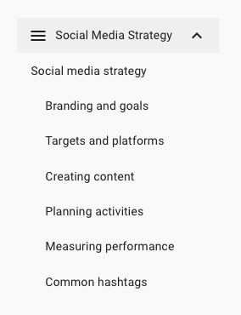
Example block types

Slide 11
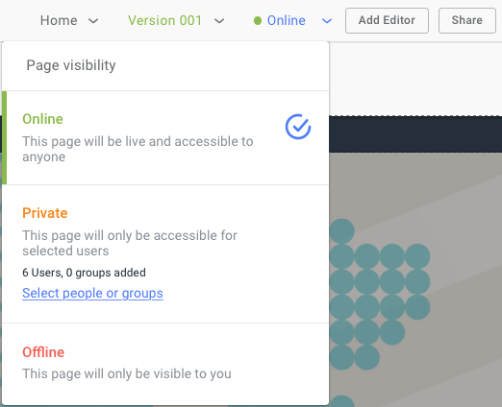
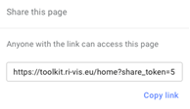
Version control, page visibility and sharing
Independent control over who can view and edit pages
Version control for pages to edit without making live changes
Public sharing links for external collaborators

Slide 12
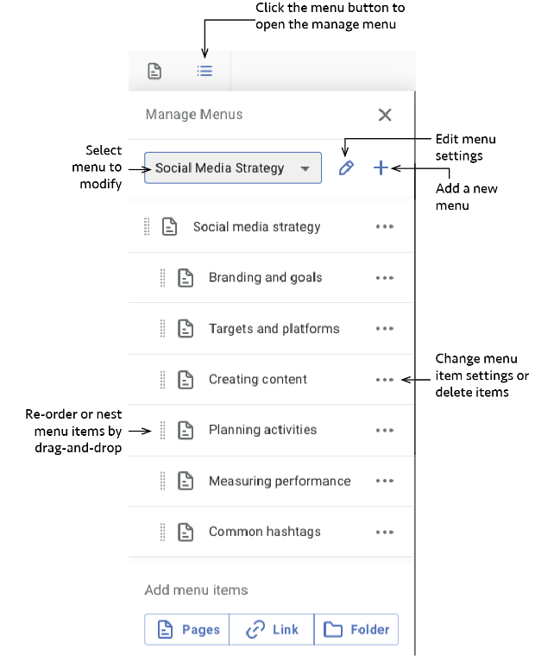
Menus
Sub-menu block
Main menu
Footer menu

Slide 13
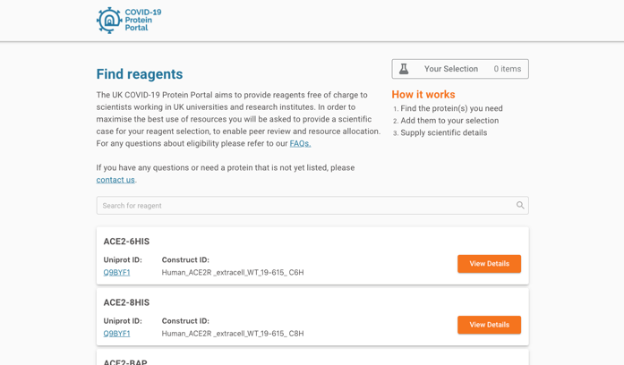
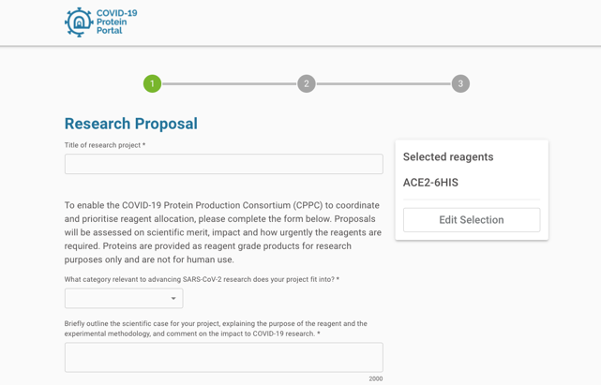
Sitebuilder in action: COVID-19 Protein Portal
Launched in May 2020, COVID-19 protein portal provided reagents for COVID-19 research at early stages of pandemic
Application interface was first real-world use of SiteBuilder
https://www.dundee.ac.uk/stories/uk-consortium-launches-covid-19-protein-portal
Notes:
It was quickly realised that the essential protein production expertise which produces proteins of exquisite quality for structural characterisation could be immediately engaged for many other purposes, for example as reagents for diagnostic testing, for research into immune responsiveness and drug screening. This led to the launch of the COVID-19 protein portal, which was a repurposed configuration of the ARIA access management system as an online platform that enabled scientists to search and request protein reagents for critical research in SARS-CoV-2. Initially launched in the UK supported by national funding.

Slide 14
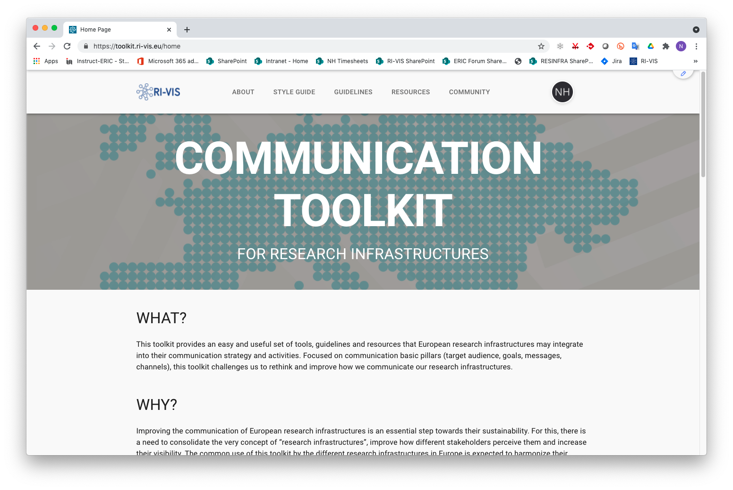
RI-VIS online toolkit launched at toolkit.ri-vis.eu

Slide 15
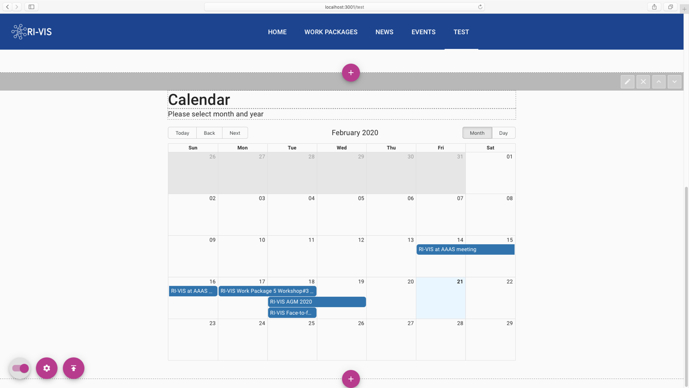
Future…
Global settings/configuration interface
Events/News blocks
Analytics
Migrate ARIA front-end
to SiteBuilder

Slide 16
Acknowledgements
Thanks to
ARIA development team,
COVID-19 Protein Production Consortium
RI-VIS Communication Toolkit team
ERIC Forum project
For development, testing, feedback and input on ARIA Sitebuilder and its prototypes

Slide 17
Collaboration Tools
Expanded ARIA research infrastructure software suite with improved website builder – makes it easy for communities to build websites to share information and resources
Portals for European research infrastructure services – find out what we provide at https://ri-vis.eu/network/rivis/portal
Compilation of resources to help with research infrastructure collaborations available at https://ri-vis.eu/network/rivis/resources

Slide 18
API-first Architecture

Slide 19
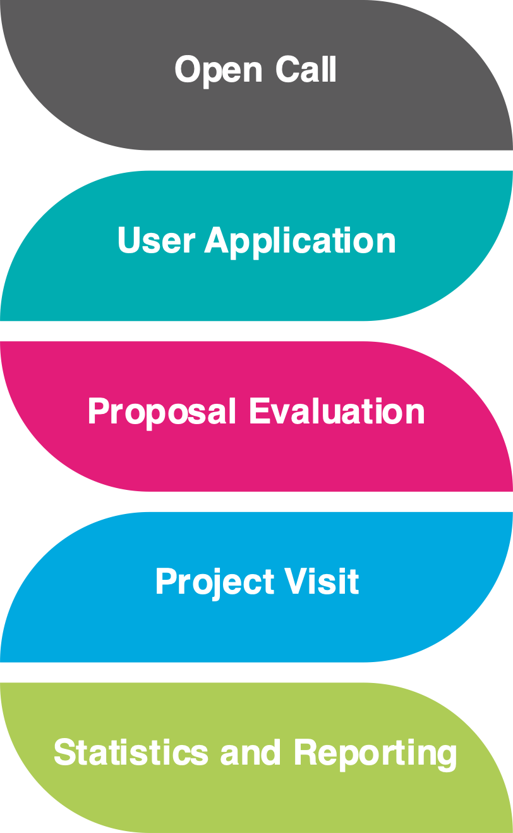
Managing Proposals without ARIA
Advertisement by email and
word of mouth
PDF or word document
Email submission
Insecure
Prone to error
Inefficient
Lots of manual steps
Not scalable
Reviewers assigned with spreadsheets
Manual email communication
Decision notation in individual spreadsheets
Manual tracking of project progress
via email and spreadsheets
Manual statistics calculation
Notes:
This is how other RIs currently manage their proposals

Slide 20
Managing Proposals in ARIA
Service catalogue
Custom call
Publish news item
Mailshot
Custom application form
Selection of services
Selection of machines
Assigning moderators
Scientific review
Technical review
Automated record of decision
Automated moderator, reviewer and user notifications
User and platform communication
Visits and units recording
User and facility feedback survey
Secure
Automated
User-friendly
Scalable
User statistics
Service statistics
Reviewer statistics
Feedback statistics

